Slide 1
CS 4310: Software Engineering
Lecture 7
Systems Analysis
Object-Oriented Design

Slide 2
Project Work
Requirements Document → Done!
Perform Systems Analysis
Create Analysis Document
Create Design Document
Create Prototype
Project Done!

Slide 3
Analysis Specification Document
Page 46 of the Class Notes
The Analysis Document Contains
  1. Introduction section
    Specific Project Objectives
    Overall Requirements Description
    Project Constraints and Assumptions
  2. Functional Requirements
    ERD
    DFD
    Process Descriptions
    Design Specification Description
    Performance and Reliability Requirements
    UML Diagrams (Component Diagrams)
    Test Plan

Slide 4
Structure Analysis Phase
Previously Covered…
Entity Relations shown in ERD format
Data Flow shown in DFD format
Data, Actions and Entities are separated for clarity

Slide 5
Structure Analysis vs. Object-Oriented Design
Object Oriented Analysis and Design
  Uses Structured Analysis
    Uses visual representation similar to Structured Analysis
    Diagramming builds from ERD and DFD concepts
  Easy to learn
  UML standards use common sense

Slide 6
Object-Oriented Analysis Phase
Object-Oriented Design Methodology
  Reaction to perceived shortcomings in structured analysis
  The problem of larger products
  Data and action are treated as equal partners

Slide 7
Object-Oriented Analysis
Object consists of
  Data (attributes, state variables, instance variables, fields, data members), and
  Actions (methods, member functions)
Objects are independent units
  Conceptual independence
  Physical independence

Slide 8
Different OO Methods
Many different methods exist
  Booch
  OMT
  Objectory
  Shlaer-Mellor
  Coad-Yourdon
All are essentially equivalent
Nowadays, we represent OOA using UML (Unified Modeling Language)

Slide 9
The Three Steps of OOA
1. Use-case modeling
  Determine how the various results are computed by the product (without regard to sequencing)
  Largely action-oriented
2. Class modeling (“object modeling”)
  Determine the classes and their attributes
  Purely data-oriented
3. Dynamic modeling
  Determine the actions performed by or to each class
  Purely action-oriented
The process is iterative

Slide 10
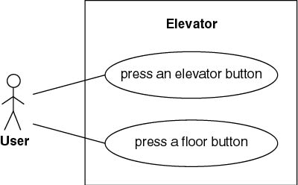
Elevator Problem: OOA
1. Use-Case Modeling
  Use case: Generic description of overall functionality
  Scenario: Instance of a use case
Get comprehensive insight into behavior of product

Slide 11
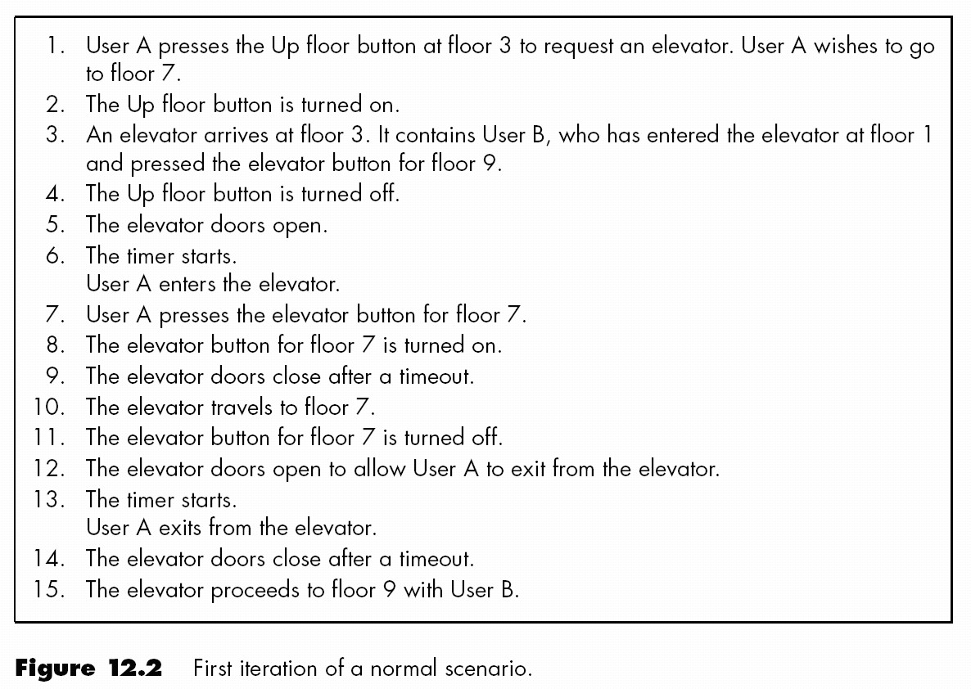
Use CASE Scenario

Slide 12
Class Modeling
Extract classes and their attributes
Represent them using an entity-relationship diagram
Deduce the classes from use cases and their scenarios
Often there are many scenarios

Slide 13
Two Approaches to Class Modeling
Noun extraction
  Always works
CRC cards
  Need to have domain expertise

Slide 14
Noun Extraction
Concise Problem Definition
  Define product in single sentence
    Buttons in elevators and on the floors control the motion of n elevators in a building with m floors.

Slide 15
Noun Extraction
Identify nouns in the informal strategy
Nouns
  button, elevator, floor, movement, building, illumination, request, door
  floor, building, door are outside problem boundary — exclude
  movement, illumination, request are abstract nouns — exclude (they may become attributes)
Create classes: Elevator and Button

Slide 16
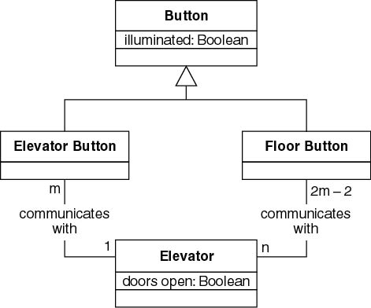
First Iteration of Class Diagram
Problem
  Buttons do not communicate directly with elevators
  We need an additional class: Elevator Controller

Slide 17
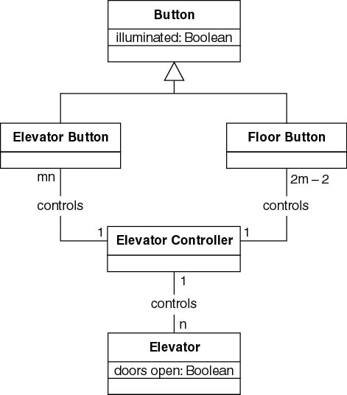
Second Iteration of Class Diagram

Slide 18
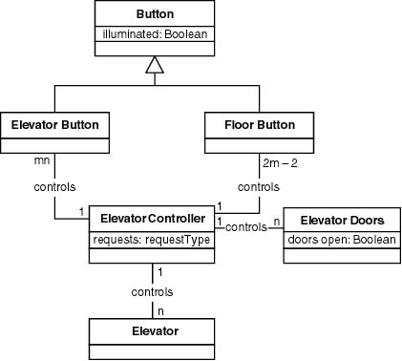
Third Iteration of Class Diagram

Slide 19
Why is Iteration Needed?
Perhaps the method is not yet mature?
  Waterfall model (explicit feedback loops)
  Rapid prototyping model (aim: to reduce iteration)
  Incremental model (explicit iterative approach)
  Spiral model (explicit iterative approach)
Iteration is a property of all software production
  Especially for medium- and large-scale products
  Expect iteration in the object-oriented paradigm

Slide 20
CRC Cards
Used since 1989 for OOA
For each class, fill in card showing
  Name of Class
  Functionality (Responsibility)
  List of classes it invokes (Collaboration)
Strength
  When acted out by team members, CRC cards are a powerful tool for highlighting missing or incorrect items
Weakness
  Domain expertise is needed

Slide 21
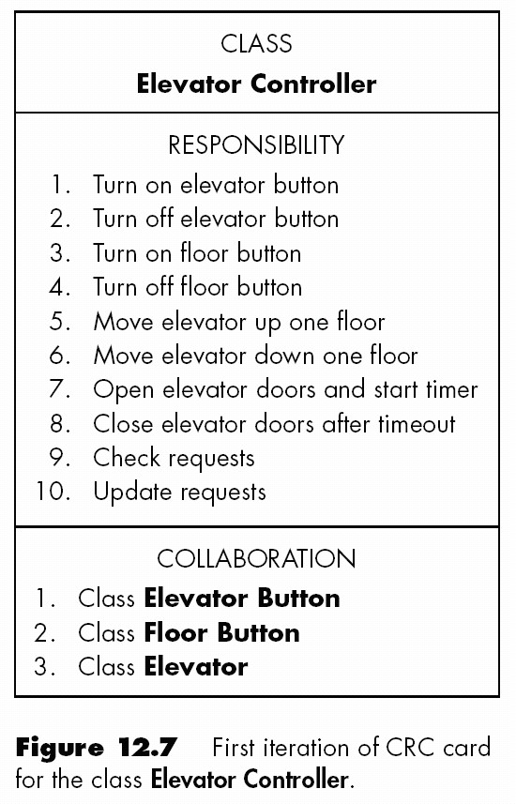
Example CRC Cards

Slide 22
Dynamic Modeling
Produce UML state diagram
State, event, predicate are distributed over the state diagram

Slide 23
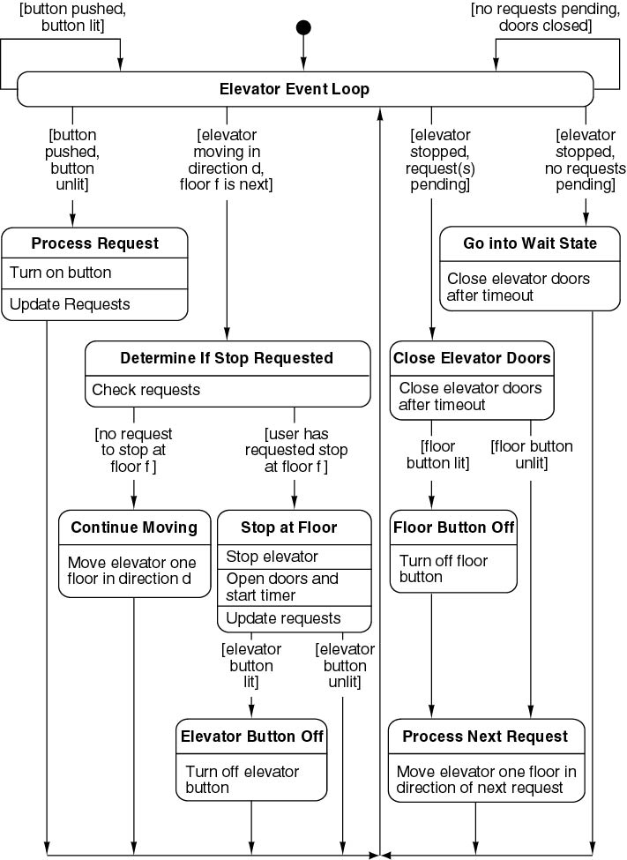
State Diagram

Slide 24
Modeling Tools
SmartDraw, 30-day trial version is available for FREE: http://www.smartdraw.com/
Microsoft Visio
System Architect
CASE Tools
Many other drawing tool

Slide 25
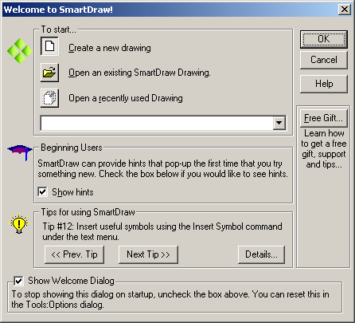
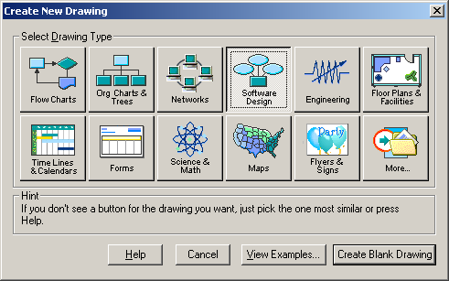
SmartDraw Software Design Option
1
2
3

Slide 26
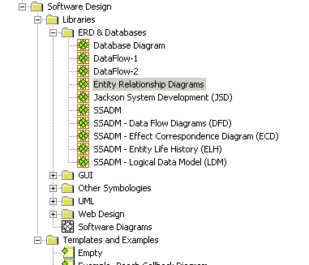
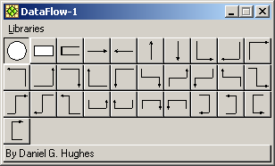
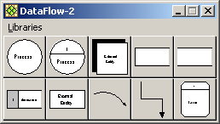
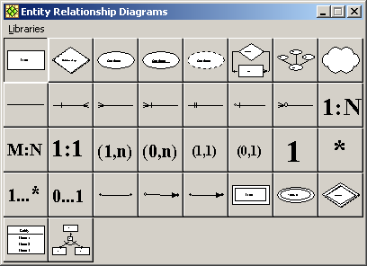
SmartDraw Components & Symbols

Slide 27
Project Work
Work in your teams to create your Analysis Document
Your Analysis Document is due very soon!
Next time we will discuss UML and OOD in more detail.

